Slide 1
SoftHier Bi-Weekly Meeting
Chi Zhang chizhang@iis.ee.ethz.ch
Thomas Benz tbenz@iis.ee.ethz.ch
Luca Colagrande colluca@iis.ee.ethz.ch

Slide 2
SoftHier Progress General Updates
DeepSeek-V3 on SoftHier: Decoding Analysis

Slide 3
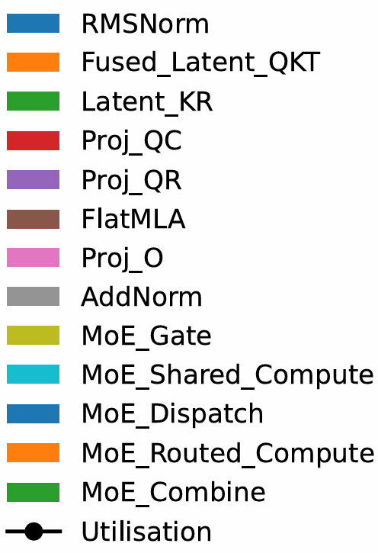
Weight Absorption
DeepSeekV3 Dataflow on SoftHier
MLA
Weight absorption tricks + FlatMLA

Slide 4
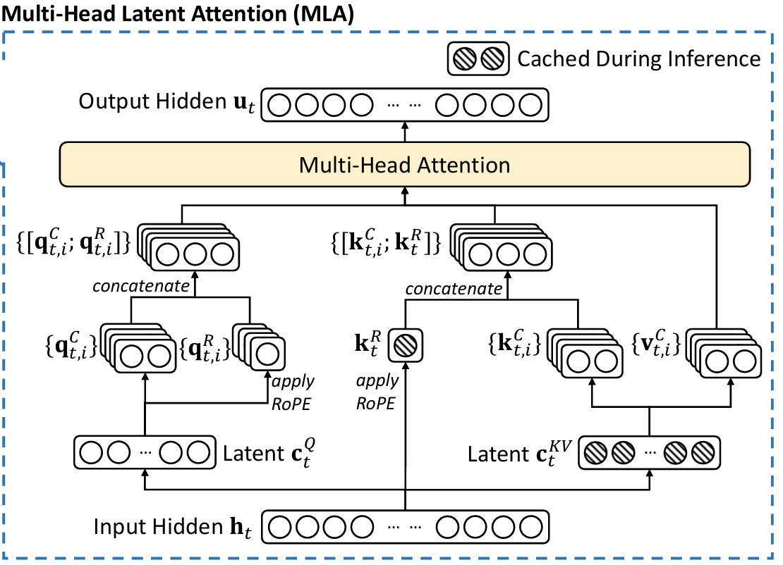
FLatMLA -- Recap
Standard MHA
Decompression + RoPE information appending
-> Forming Q,K,V
Low-Rank Compression
-> Latent matrices

Slide 5
MLA Decode Can Be Compute-Bound
K₀
V₀
The MHA part:
All GEMV Operations
-- Memory-bound
Head 0
×
₍
₎^{T}
SoftMax
×
K₁
V₁
Head 1
×
₍
₎^{T}
SoftMax
×
…
×
……
W^{O}
K_{h}
V_{h}
Head h
×
₍
₎^{T}
SoftMax
×

Slide 6
MLA Decode Can Be Compute-Bound
C^{KV}
C^{KV}
W₀^{UQ}
W₀^{UK}
SoftMax
W₀^{UV}
Merge Decompress to MHA part
Head 0
₍
×
₎
×
₍
×
₎^{T}
×
₍
×
₎
C^{KV}
C^{KV}
W₁^{UQ}
W₁^{UK}
SoftMax
W₁^{UV}
Head 1
₍
×
₎
×
₍
×
₎^{T}
×
₍
×
₎
…
×
……
W^{O}
C^{KV}
C^{KV}
W_{h}^{UQ}
W_{h}^{UK}
SoftMax
W_{h}^{UV}
Head h
₍
×
₎
×
₍
×
₎^{T}
×
₍
×
₎

Slide 7
MLA Decode Can Be Compute-Bound
C^{KV}
C^{KV}
W₀^{UQ}
W₀^{UK}
SoftMax
W₀^{UV}
Formular transformation
Head 0
×
×
×
×
×
C^{KV}
C^{KV}
W₁^{UQ}
W₁^{UK}
SoftMax
W₁^{UV}
Head 1
×
×
×
×
×
…
×
……
W^{O}
C^{KV}
C^{KV}
W_{h}^{UQ}
W_{h}^{UK}
SoftMax
W_{h}^{UV}
Head h
×
×
×
×
×

Slide 8
MLA Decode Can Be Compute-Bound
C^{KV}
C^{KV}
W₀^{UQ}
W₀^{UK}
SoftMax
W₀^{UV}
Weight absorption
Head 0
×
×
×
×
×
Weight absorption
C^{KV}
C^{KV}
W₁^{UQ}
W₁^{UK}
SoftMax
W₁^{UV}
Head 1
×
×
×
×
×
…
Weight absorption
×
……
W^{O}
C^{KV}
C^{KV}
W_{h}^{UQ}
W_{h}^{UK}
SoftMax
W_{h}^{UV}
Head h
×
×
×
×
×
Weight absorption

Slide 9
MLA Decode Can Be Compute-Bound
C^{KV}
C^{KV}
W₀^{UQK}
SoftMax
Head 0
×
×
×
…
×
×
×
W₀^{UV}
W₁^{UV}
W_{h}^{UV}
C^{KV}
C^{KV}
W₁^{UQK}
SoftMax
Head 1
×
×
×
…
×
……
W^{VO}
C^{KV}
C^{KV}
Head h
W_{h}^{UQK}
SoftMax
×
×
×

Slide 10
Inter head merging
MLA Decode Can Be Compute-Bound
C^{KV}
C^{KV}
W₀^{UQK}
SoftMax
Head 0
×
×
×
…
×
×
×
W₀^{UV}
W₁^{UV}
W_{h}^{UV}
C^{KV}
C^{KV}
W₁^{UQK}
SoftMax
Head 1
×
×
×
…
×
……
W^{VO}
C^{KV}
C^{KV}
Head h
W_{h}^{UQK}
SoftMax
×
×
×
Merge
Merge

Slide 11
MLA Decode Can Be Compute-Bound
W₀^{UQK}
W₁^{UQK}
W_{h}^{UQK}
…
×
C^{KV}
C^{KV}
Nb_head
…
×
SoftMax
…
×
…
W^{VO}
…
…
×
×
×
×
W₀^{UV}
W₁^{UV}
W_{h}^{UV}

Slide 12
MLA Decode Can Be Compute-Bound
W₀^{UQK}
W₁^{UQK}
W_{h}^{UQK}
…
×
Fold
C^{KV}
C^{KV}
Nb_head
…
×
SoftMax
…
×
…
Flat
W^{VO}
…
…
×
×
×
×
W₀^{UV}
W₁^{UV}
W_{h}^{UV}

Slide 13
MLA Decode Can Be Compute-Bound
Memory-bound for weight-related operation
W₀^{UQK}
W₁^{UQK}
W_{h}^{UQK}
…
×
Compute-bound for the key MHA
Fold
C^{KV}
C^{KV}
Nb_head
…
×
SoftMax
…
×
…
Flat
W^{VO}
…
…
×
×
×
×
W₀^{UV}
W₁^{UV}
W_{h}^{UV}

Slide 14
MLA Decode Can Be Compute-Bound
Batching various user’s token:
Weight related operation -> Compute-bound
W₀^{UQK}
W₁^{UQK}
W_{h}^{UQK}
…
×
Nb_user
Fold
C^{KV} of Usr0
C^{KV} of user0
×
SoftMax
Nb_head
Of user0
…
×
…
Flat
Proj_O
…
C^{KV}
of User1
C^{KV} of user1
×
SoftMax
Nb_head
Of user1
…
×
…
Batching does not help for the Key MHA part
(User has their own context, ie. KV cache)
……

Slide 15
MLA Decode Can Be Compute-Bound (Speculative Decoding)
Batching various user’s token:
Weight related operation -> Compute-bound
W₀^{UQK}
W₁^{UQK}
W_{h}^{UQK}
…
×
Nb_user * Draft_len(k)
Fold
C^{KV} of Usr0
C^{KV} of user0
k
×
SoftMax
Nb_head
Of user0
…
×
…
Flat
Proj_O
…
C^{KV}
of User1
C^{KV} of user1
k
Nb_head
Of user1
×
SoftMax
…
×
…
Batching does not help for the Key MHA part
(User has their own context, ie. KV cache)
……

Slide 16
FlatMLA Decode Results
FlatMLA implementation
Key idea of FlatAttention + FlashMLA
SoftHier
32x32 tiles, 1024 TFLOPS @FP16, 4TB/s HBM BW
MLA decode
Batch size = 1024
Assume every user has the same KV cache length

Slide 17
Weight Absorption
DeepSeekV3 Dataflow on SoftHier
MLA
Weight absorption tricks + FlatMLA
MoE
First compute shared expert
Dispatch tokens for routed experts
Compute per routed expert
Combine weighted outputs

Slide 18
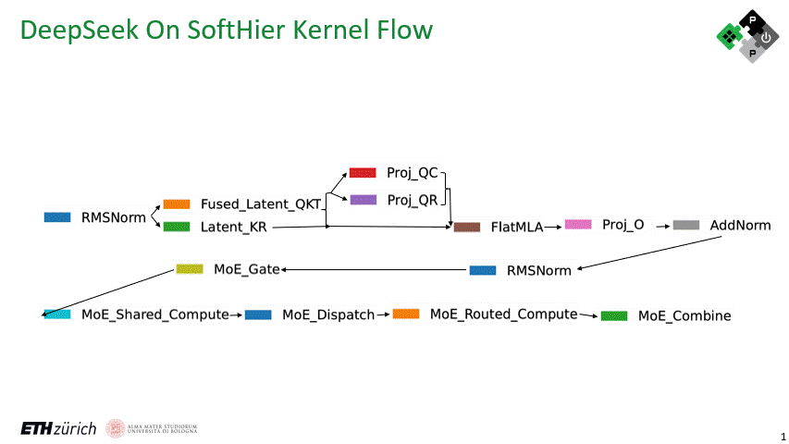
Weight Absorption
DeepSeekV3 Dataflow on SoftHier
MLA
Weight absorption tricks + FlatMLA
MoE
First compute shared expert
Dispatch tokens for routed experts
Compute per routed expert
Combine weighted outputs

Slide 19
Experiment Setup
SoftHier Config
1024 TFLOPs @ FP16, 4TB/s HBM BW (2TB/s on West and South Edge)
Test Scenario
Speculative decoding (k=4), acceptance rate 0.75
KV cache length: 4096 tokens per user, Balanced expert routing
Full DeepSeek-671B, with Pipeline Parallelism (PP): 61 SoftHier Chips, each handling 1 layer
Key Metrics
Throughput: tokens/s/chip
TPOT: avg. time per token for each user (target <100 ms)
Layer 0
Layer 1
Layer 2
Layer n
k
SoftHier
Chip
SoftHier
Chip
SoftHier
Chip
SoftHier
Chip
batch
k
k
k

Slide 20
Pipeline Parallelism Results
Target

Slide 21
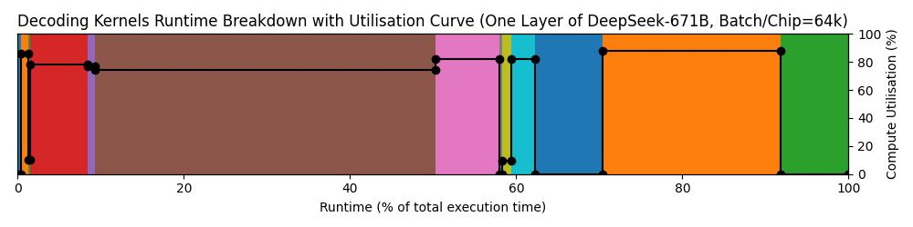
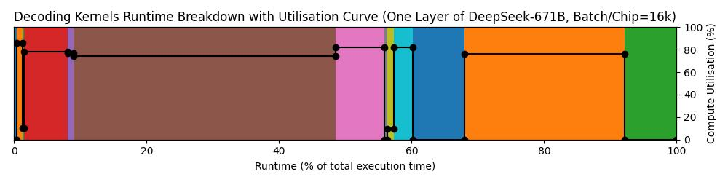
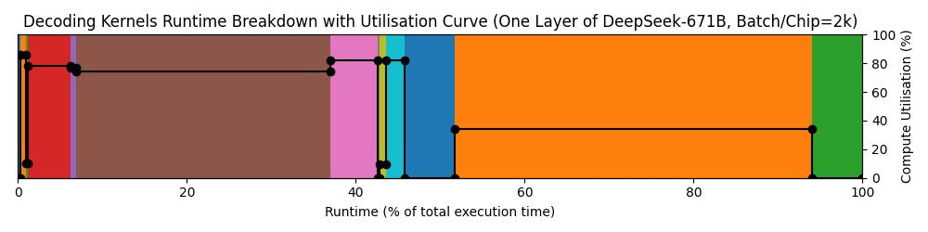
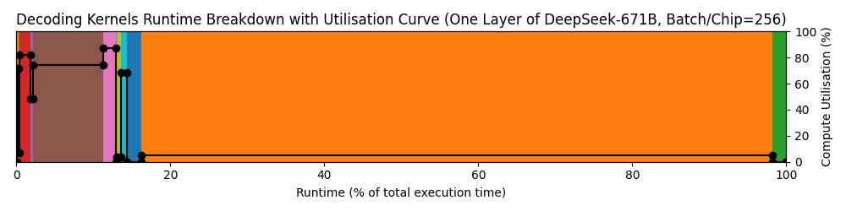
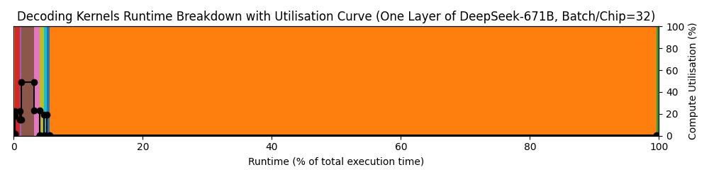
Pipeline Parallelism Results
Batch/Chip = 64k
Overall Uti = 65%
V
Batch/Chip = 16k
Overall Uti = 63%
Batch/Chip = 2k
Overall Uti = 48%
Batch/Chip = 256
Overall Uti = 15%
Batch/Chip = 32
Overall Uti = 2%

Slide 22
Pipeline Parallelism Results
Performance
Fails TPOT constraint (<100 ms) even at low batch sizes
Example: TPOT ~127 ms with 8 batch/chip
Bottlenecks
Low MoE utilization due to low shared token per expert
Very high batch sizes improve utilization, But:
TPOT becomes unacceptable (e.g., 19 s per token)
Large KV caches exacerbate memory use

Slide 23
Expert Parallelism (EP) Approach
Concept
Each chip handles a subset of experts in parallel
Requires heavy inter-chip communication (dispatch & combine)
MLA + Shared Expert + Gate
Dispatch
Routed Expert
Combine
Expert 0
SoftHier
Chip 0
k
SoftHier
Chip 0
SoftHier
Chip 0
SoftHier
Chip 0
Expert 1
batch
k
Expert 2
k
Expert 3
k
Expert 4
SoftHier
Chip 1
k
SoftHier
Chip 1
SoftHier
Chip 1
SoftHier
Chip 1
Expert 5
batch
k
Expert 6
k
Expert 7
k
C2C Interconnect
Expert 8
SoftHier
Chip 2
k
SoftHier
Chip 2
SoftHier
Chip 2
SoftHier
Chip 2
Expert 9
batch
k
Expert 10
k
Expert 11
k
……
……
……
……
Expert 252
SoftHier
Chip 63
k
SoftHier
Chip 63
SoftHier
Chip 63
SoftHier
Chip 63
Expert 253
batch
k
Expert 254
k
Expert 255
k
Time

Slide 24
Expert Parallelism (EP) Approach
Expert 0
SoftHier
Chip 0
Expert 1
Concept
Each chip handles a subset of experts in parallel
Requires heavy inter-chip communication (dispatch & combine)
Implementation
Overlaps communication with kernel execution
Expert 2
Expert 3
Expert 4
SoftHier
Chip 1
Expert 5
Expert 6
Expert 7
C2C Interconnect
Expert 8
SoftHier
Chip 2
Expert 9
Expert 10
Expert 11
……
Expert 252
SoftHier
Chip 63
Expert 253
Expert 254
Expert 255
Kernel Compute
MLA + Shared Expert + Gate
MLA + Shared Expert + Gate
Routed Expert
Routed Expert
MLA + Shared Expert + Gate
C2C Communication
Dispatch
Dispatch
Combine
Combine
Time

Slide 25
Expert Parallelism Results
Target

Slide 26
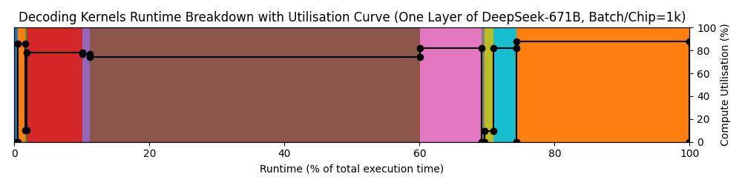
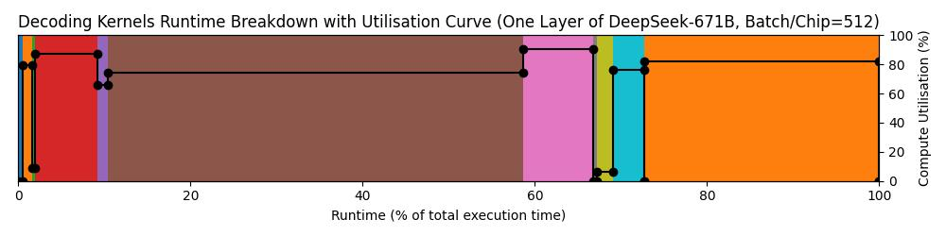
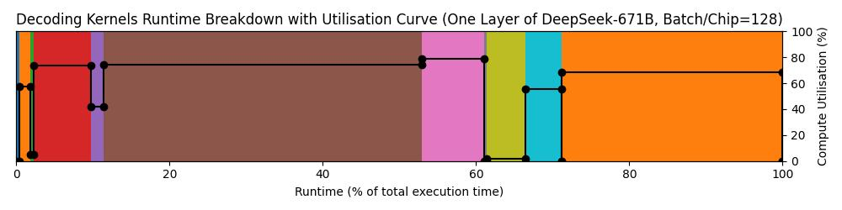
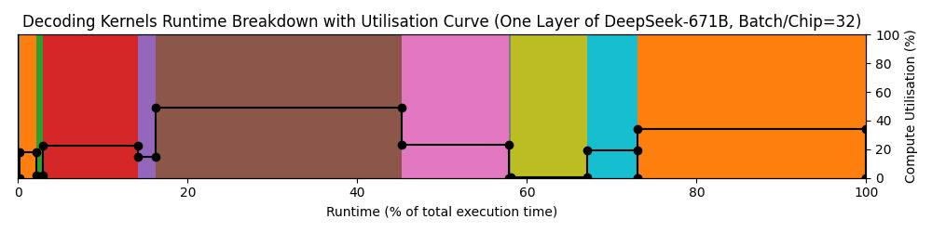
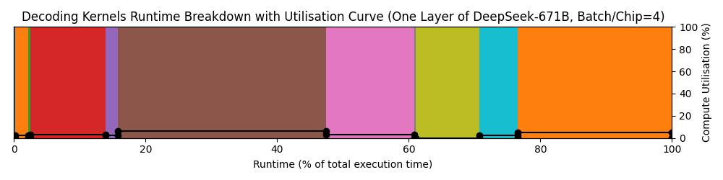
Expert Parallelism Results
Batch/Chip = 1024
Overall Uti = 78%
V
Batch/Chip = 512
Overall Uti = 73%
Batch/Chip = 128
Overall Uti = 67%
Batch/Chip = 32
Overall Uti = 31%
Batch/Chip = 4
Overall Uti = 4%

Slide 27
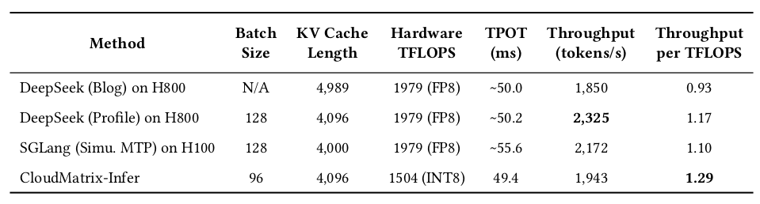
Expert Parallelism Results
Performance
TPOT significantly improved
Example: Batch size=128 → TPOT=73 ms, throughput=3497 tokens/s/chip
Utilization up to 78% at higher batch sizes (with higher TPOT)
Comparison with SoA
SoftHier Speculative Decoding
(draft_len=4, accept rate=0.75)
128
4096
1024(FP16)
73
3497
3.41
SoftHier Speculative Decoding
(draft_len=4, accept rate=0.75)
128
4096
2048(FP8)
Coming Soon

Slide 28
Limitations & Open Questions
Assumptions Review
Speculative decoding (k=4), acceptance rate 0.75
Uniform KV cache length & balanced expert load
Ideal inter-chip bandwidth (One way ≥ 100 GB/s to overlap with kernel computation)
Challenges
Dynamic workloads and variable KV cache lengths
Off-chip interconnects in Chiplet systems (Network on Interposer/Substrate)
Network on Interposer : Explore collective primitives and smart routers (dispatch/combine)
Evaluate various interconnect topologies and bandwidth
SoftHier
Chip 0
SoftHier
Chip 1
SoftHier
Chip 2
R
R
R
SoftHier
Chip 3
SoftHier
Chip 4
SoftHier
Chip 5
R
R
R
SoftHier
Chip 6
SoftHier
Chip 7
SoftHier
Chip 8
R
R
R
Active Interposer?

Slide 29
Plan For Next
ISVLSI Conference 7th July – 9th July
Double-Check the result, Clean up kernel code and add numerical checking points
Try to further improve utilization at the optimal batch size
Benchmark the performance for FP8 also

Slide 30
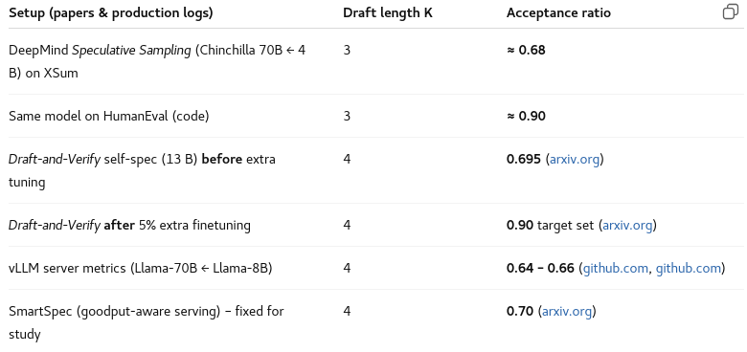
Reference

Slide 31
SoftHier HW Improvements
HBM CTRL Port Aliasing
Unified address space across HBM ports on one edge
Address bits >48 distinguish ports
Xbar inside HBM CTRL ensures even interleaving (with address scrambling)
Simplifies programming model and supports dynamic workloads
Tile
Tile
Tile
Tile
Base = 0x0000000000000000
0x00000000_00000000
0x00000000_FFFFFFFF
0x00000000_00000000
0x00000003_FFFFFFFF
Tile
Tile
Tile
Tile
R
R
R
R
R
R
R
R
Tile
Tile
Tile
Tile
Base = 0x0001000000000000
0x00000001_00000000
0x00000001_FFFFFFFF
Tile
Tile
Tile
Tile
R
R
R
R
HBM CTRL
R
R
R
R
HBM CTRL
Tile
Tile
Tile
Tile
Tile
Tile
Tile
Tile
xbar
Base = 0x0002000000000000
0x00000002_00000000
0x00000002_FFFFFFFF
R
R
R
R
R
R
R
R
Tile
Tile
Tile
Tile
Tile
Tile
Tile
Tile
Base = 0x0003000000000000
0x00000003_00000000
0x00000003_FFFFFFFF
R
R
R
R
R
R
R
R

